Slide 1
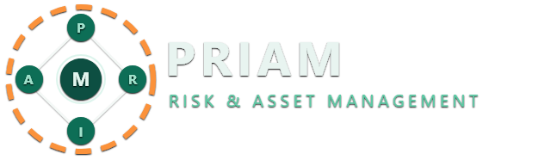
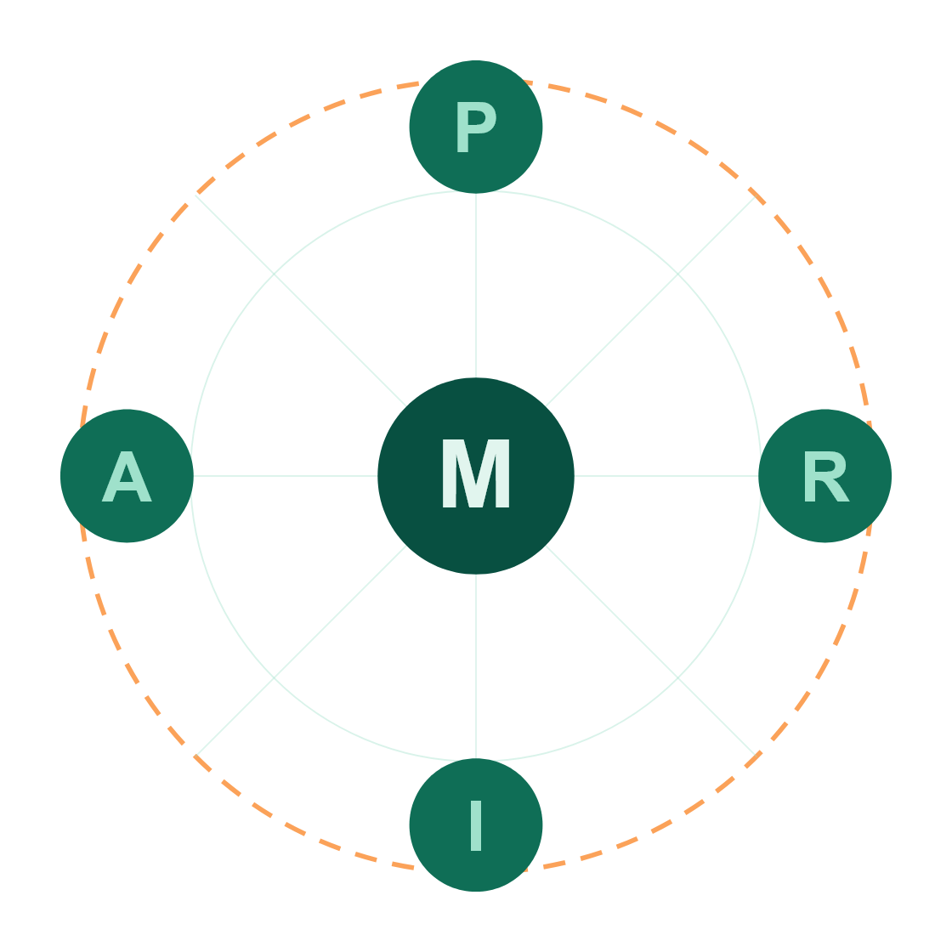
RISK & ASSET MANAGEMENT FOR SMALL BUSINESS
Risk visibility, without the GRC team.
Policy. Risk. Incident. Asset.
One platform — sized for the way small businesses actually work.
Notes:
Welcome. PRIAM stands for Policy, Risk, Incident, Asset, Management — a single platform built specifically for small businesses. Today: what we built, why it matters, and how it works in practice.

Slide 2
THE REALITY
The risks small businesses face every day.
VERIZON DBIR — 2024
U.S. BANK STUDY
ACROSS THE WEEK
43%
82%
A lost laptop. A phishing click. A supplier outage. A missed policy renewal. A customer data request.
Each one is small on its own. Together, they're a business.
of small businesses fail due to cash-flow and operational risk.
of cyber incidents target small businesses.
PRIAM 02 / 20
Notes:
Quick reality check. Lost laptops, phishing emails, supplier breaches, missed renewals — these aren't enterprise problems. They happen to small businesses every week. Most just don't have a way to track them.

Slide 3
THE GAP
Enterprise GRC
Big companies have GRC teams. Small businesses have a spreadsheet.
$60k+/year, 6-month rollout
Built for compliance officers
SMB Reality
A shared Google Sheet
If anything at all
Risk software is built for enterprises with full-time officers, audit committees, and six-figure software budgets. SMBs need the same outcomes — without any of that.
PRIAM
Day-one usable
Built for the way SMBs work
Notes:
Big companies have GRC teams, audit committees, full-time risk officers. SMBs have… a shared spreadsheet, if anything. We built PRIAM for the 99% of businesses that fall into that gap.

Slide 4
01
THE PLATFORM
A single platform for everything that might go wrong —and everything you own.
Four lightweight modules. One shared system of record. Designed so a five-person team and a fifty-person team can both use it from week one.
PRIAM 04 / 20
Notes:
PRIAM gives you four connected modules: policy, risk, incident, and asset management — each lightweight enough to use day one, integrated enough to give you a single source of truth.

Slide 5
02
THE ACRONYM
Five letters. Five connected workflows.
P
R
I
A
M
Policy
Risk
Incident
Asset
Management
Draft, publish, version, and track acknowledgement.
Adaptive, industry-specific assessments and recommendations.
Queue-based reporting with status, ownership, and audit trail.
People, customers, suppliers, devices, and vehicles in one ledger.
Roles, approvals, audit, and the dashboard that ties it together.
Notes:
These five letters aren't just branding. They map to five real workflows that share data. A policy references an asset. An incident triggers a risk re-assessment. Everything feeds the same dashboard.

Slide 6
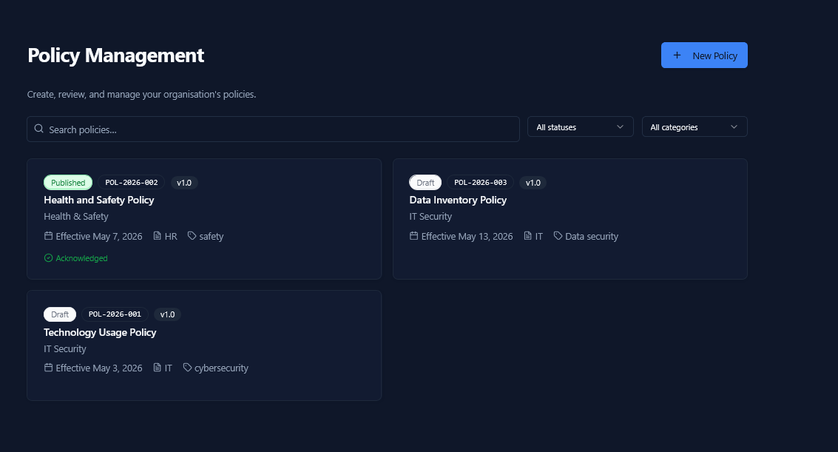
P —
POLICY
Living documents, not binders.
Every policy has a status, a version, an effective date, and a paper trail of who acknowledged it. Drafts stay drafts until you publish.
→
Draft → Published → Acknowledged
→
Categories & tags for fast filtering
→
Add-on modules: HIPAA, GDPR, SOC 2
06 / 20
Notes:
Policies as living documents, not PDFs in a binder. Draft, publish, version, acknowledge — and your team sees them where they work.

Slide 7
R —
RISK ASSESSMENT
Questionnaires that adapt to your industry, not yours to a checklist.
Pick your NAICS code at signup. PRIAM only asks what's relevant.
Without PRIAM
A 400-question generic checklist.
Adaptive (DAG engine)
NAICS-tailored
Audit-trailed
6-month retention
With PRIAM
Roughly 50 questions. Only the ones that apply to a 12-person retailer in Oregon.
Answers feed downstream — change one input, see the score and recommendations update on the spot.
Notes:
Risk assessments adapt to your industry. Pick your NAICS code, answer the questions that actually apply to you. No 400-question generic checklist.

Slide 8
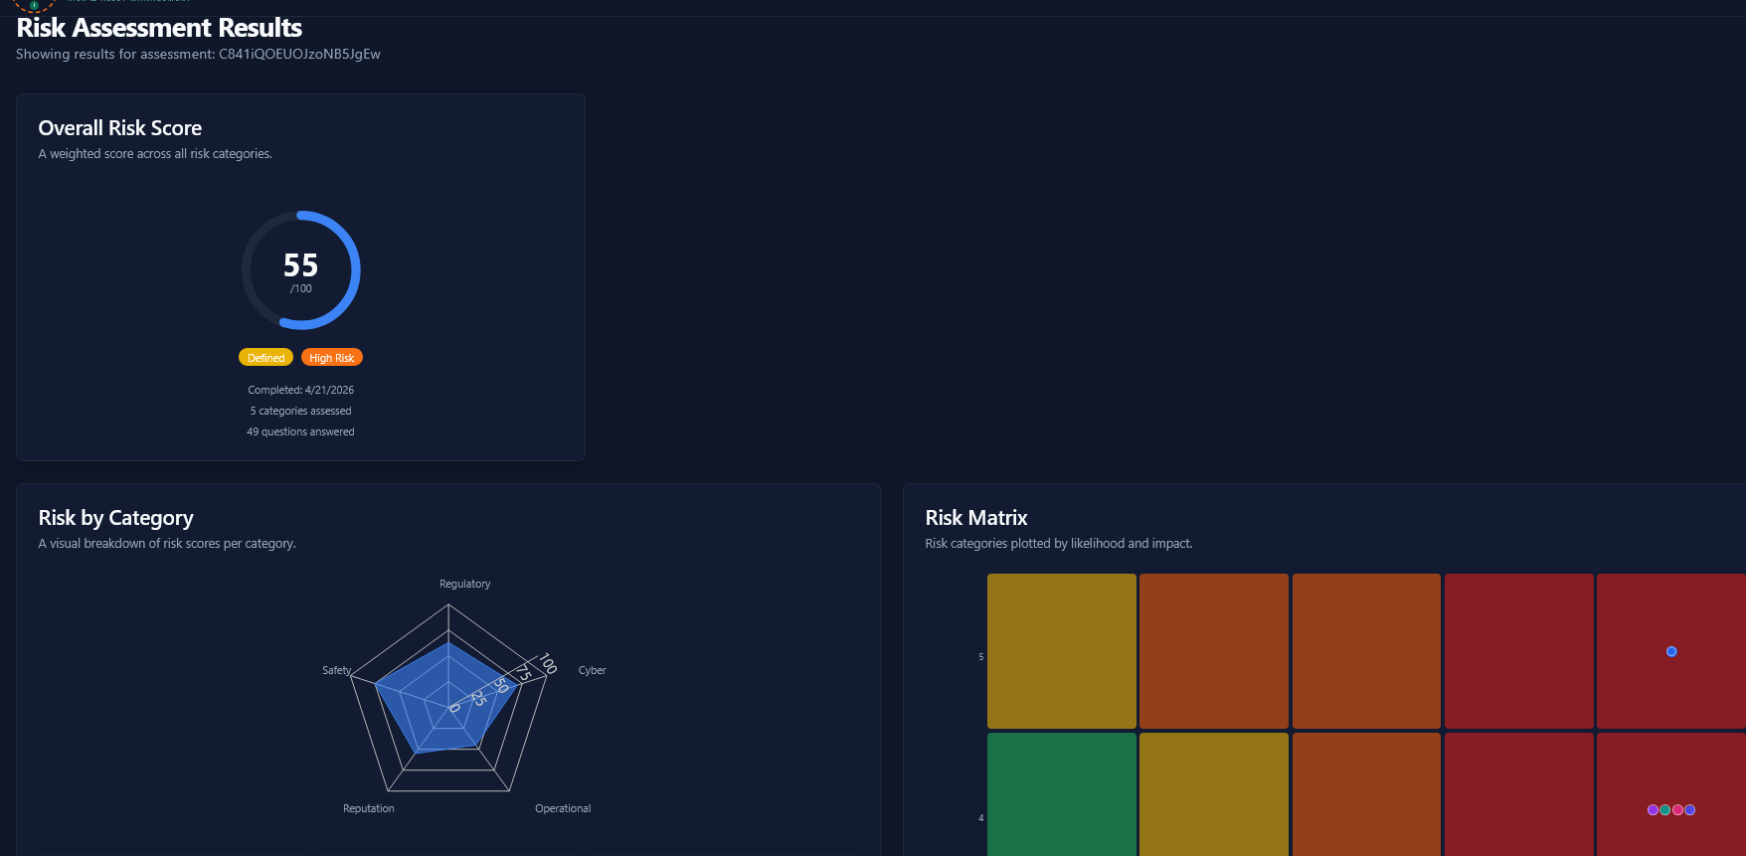
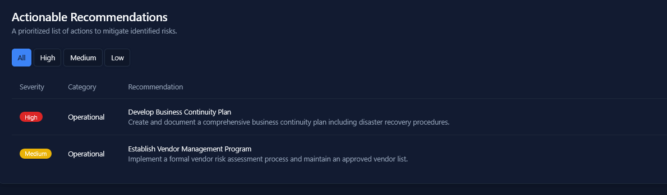
R
RESULTS & RECOMMENDATIONS
A score, a matrix, and a prioritized list of fixes.
08 / 20
Notes:
After the assessment, you get a clear number, a category breakdown, and a likelihood-vs-impact matrix. Plus a prioritized list of fixes — not just 'you have problems'.

Slide 9
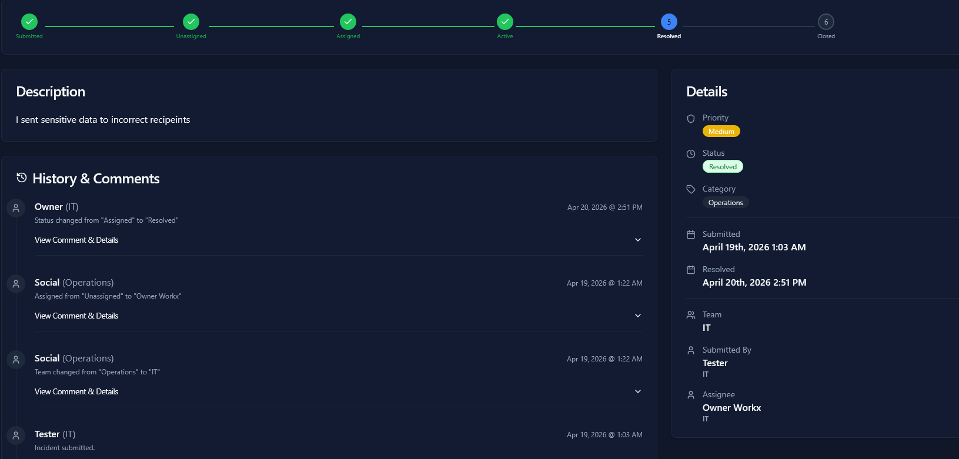
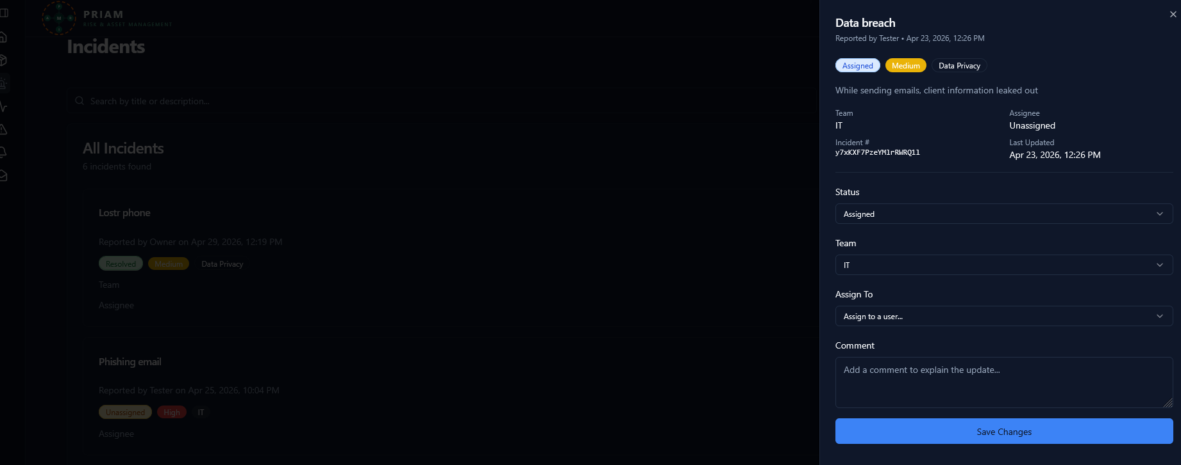
I —
INCIDENT MANAGEMENT
A queue, not an inbox.
Every incident has an owner at every stage. BullMQ-backed transitions, immutable audit trail, automatic notifications.
01 — SUBMITTED
02 — TRIAGE
03 — OWNED
04 — IN MOTION
05 — DONE
Submitted
Unassigned
Assigned
Active
Resolved
Anyone on the team can report — public or private.
Routed to the right team based on category.
A named owner with priority and SLA.
Comments, status updates, and edits — all logged.
Closed with a reason. Re-openable if it returns.
Notes:
Every incident — a lost phone, a phishing click, a customer complaint — moves through a queue with a clear owner at every step. Submitted, assigned, active, resolved, closed.

Slide 10
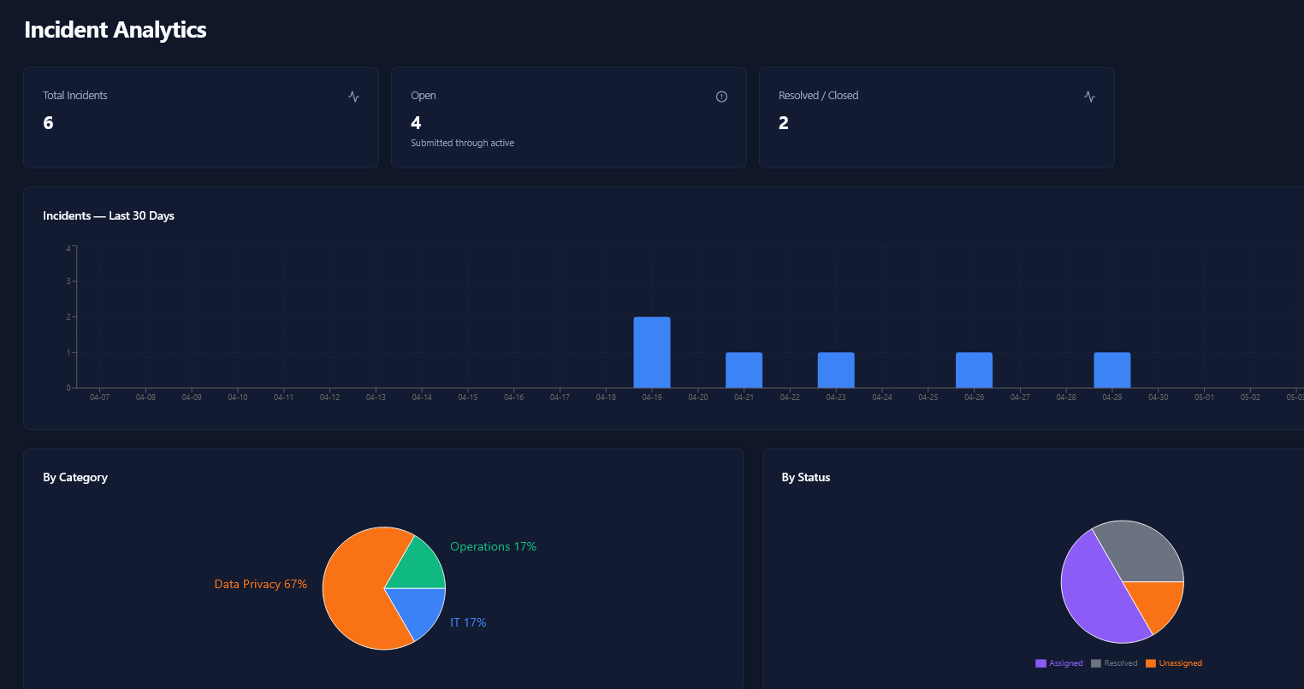
I
ANALYTICS
See patterns, not just events.
Three lost devices in a month is a procurement problem, not three tickets.
Notes:
Patterns matter more than individual events. Three lost devices in a month is a procurement problem. PRIAM shows you the trend, not just the ticket.

Slide 11





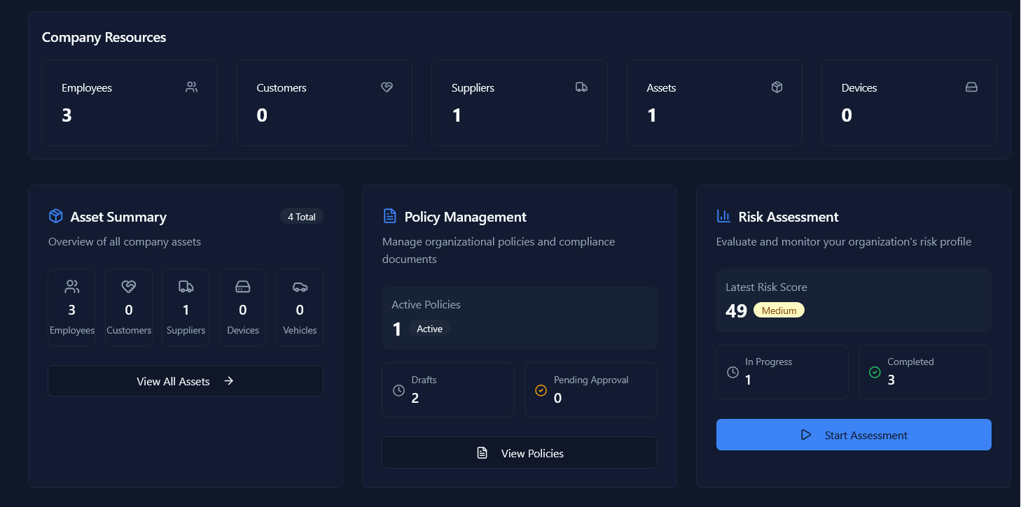
A —
ASSET MANAGEMENT
Five things every business has. One place to track them all.
Employees
Customers
Suppliers
Devices
Vehicles
Roles, departments, onboarding status.
NAICS-coded with verification workflow.
Approval-gated entries, audit-ready.
Computers, phones, peripherals.
Fleet records and assignments.
Notes:
Your assets — employees, customers, suppliers, devices, vehicles — all live in one place. When an incident references a customer or device, you see it linked.

Slide 12
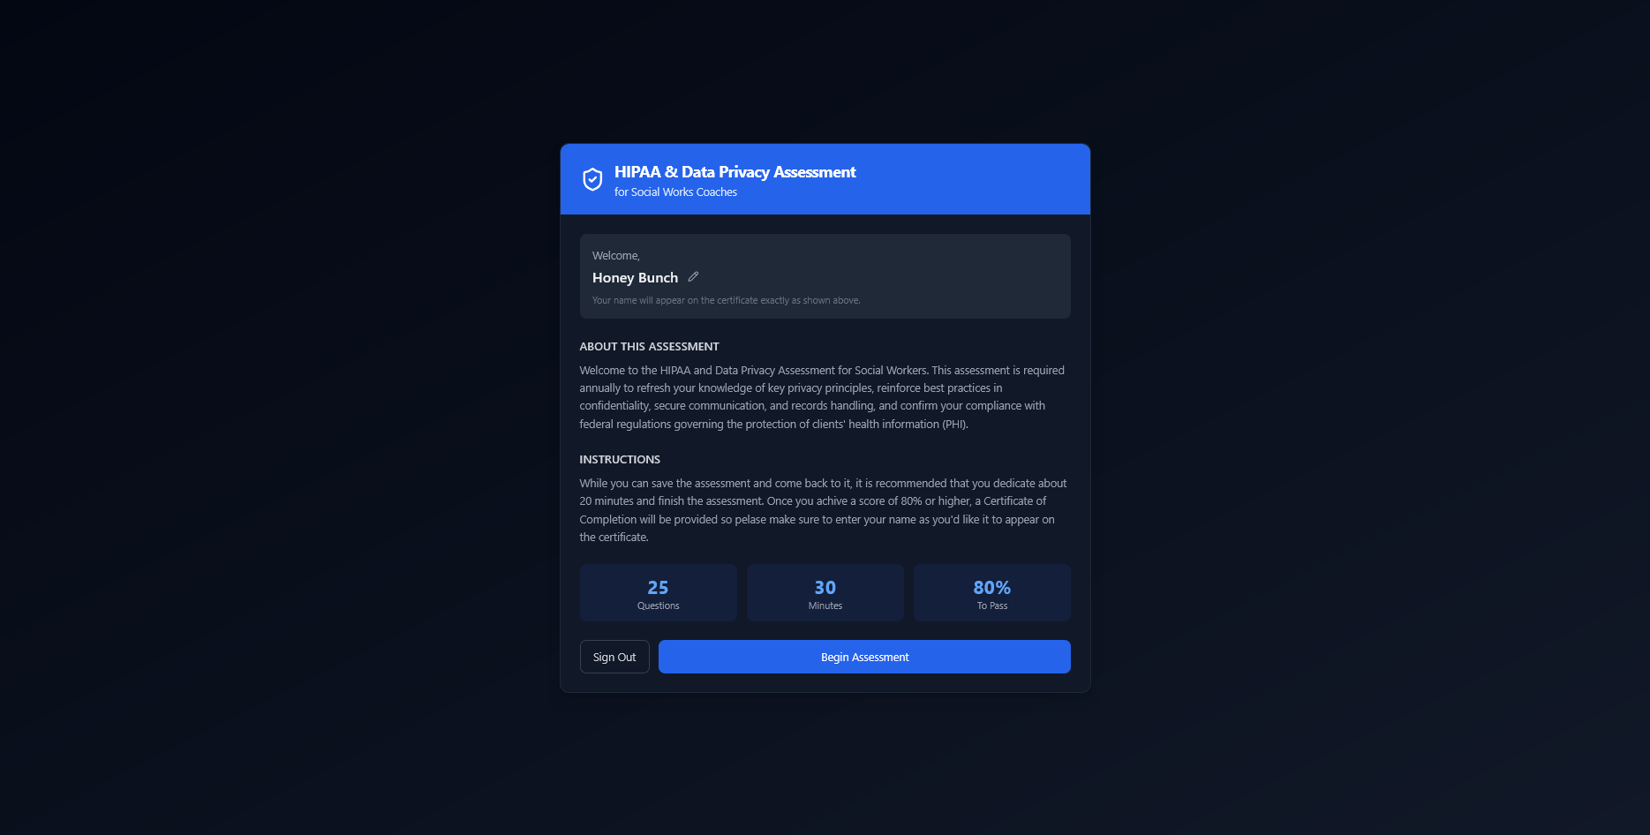
+
HIPAA & DATA PRIVACY ASSESSMENT
A guided assessment for the people on the front line.
Annual HIPAA & Data Privacy refreshers — built into PRIAM. Coaches and case workers take a 25-question, 30-minute assessment. Pass at 80% and a Certificate of Completion is generated automatically.
25 questions · multiple choice + short answer
30-minute timed window with autosave
80% to pass · explanations after every attempt
Certificate issued the moment you pass
Notes:
PRIAM ships with an annual HIPAA and Data Privacy Assessment for the front-line teams who actually handle protected health information. Twenty-five questions, thirty minutes, eighty percent to pass — and a certificate the moment you do.

Slide 13
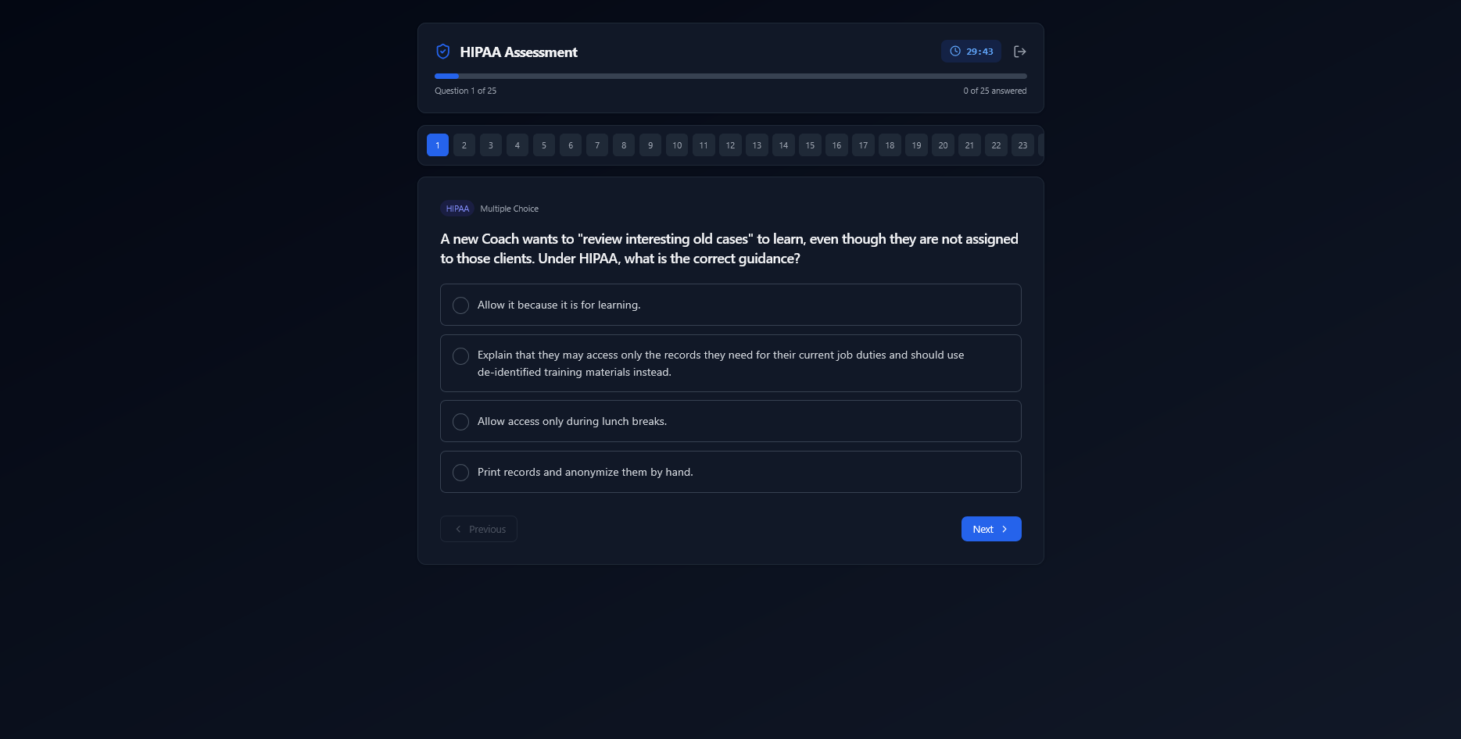
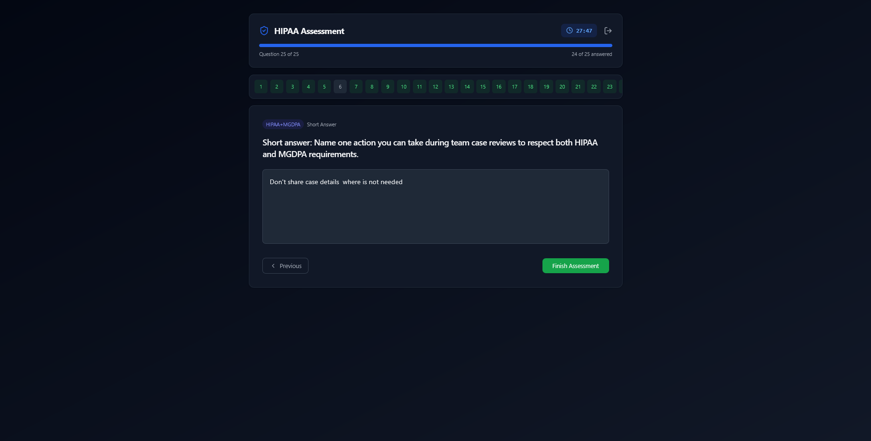
+
TAKING THE ASSESSMENT
Plain-language scenarios. Saved as you go.
Multiple-choice and short-answer prompts drawn from the situations social-services teams actually run into — with a question palette so participants can jump back to anything still unanswered.
Notes:
The questions are written in plain language around the situations social-services teams actually face. Saved as you go, with a question palette so participants can jump straight to whatever they haven't answered yet.

Slide 14
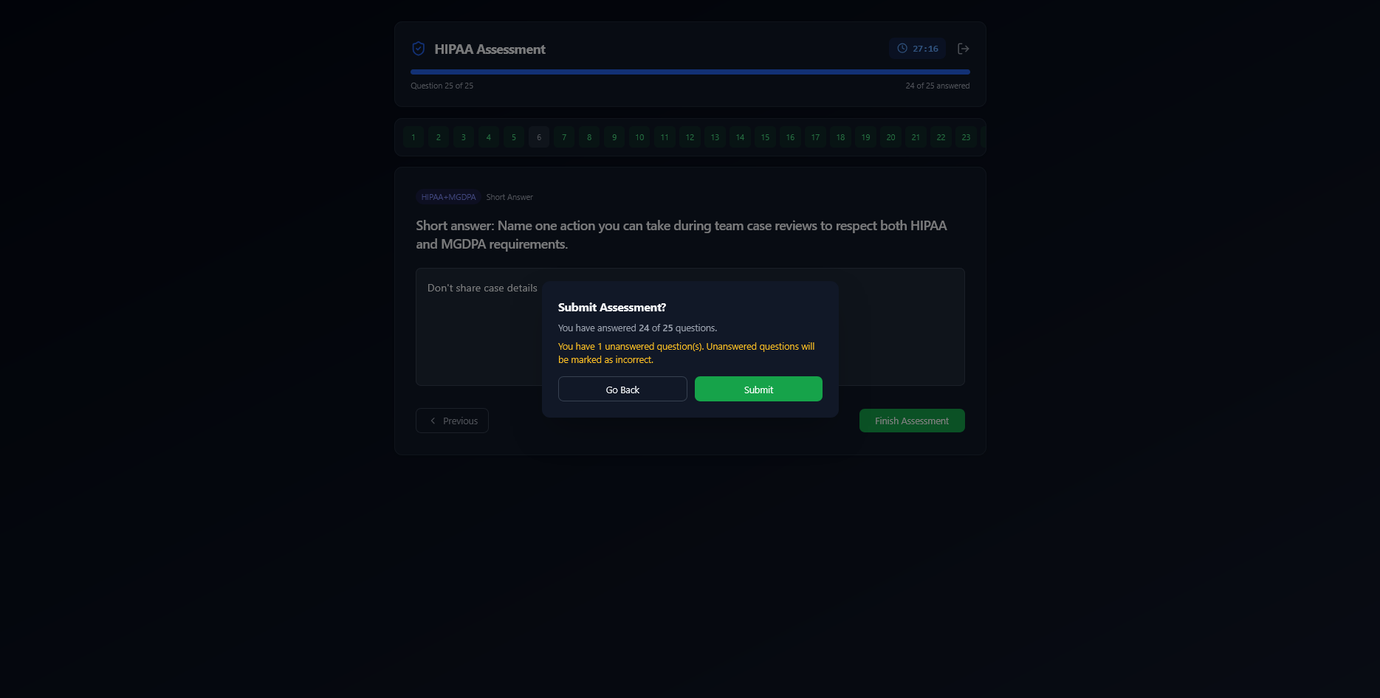
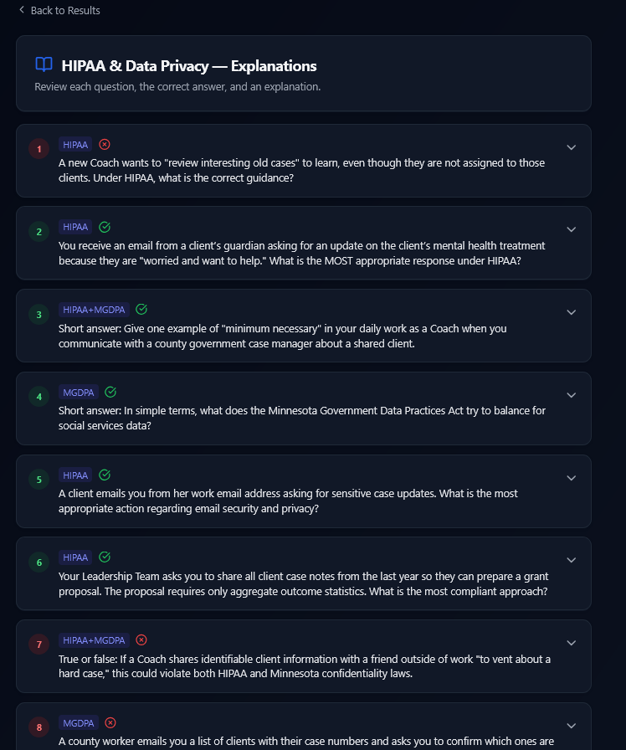
+
RESULTS & EXPLANATIONS
A score, and the reason behind every answer.
Whether you pass or not, every question gets an explanation — so the assessment doubles as training. Retakes are one click away.
Notes:
Whether someone passes or not, every question gets an explanation — so the assessment doubles as training. Retakes are one click away.

Slide 15
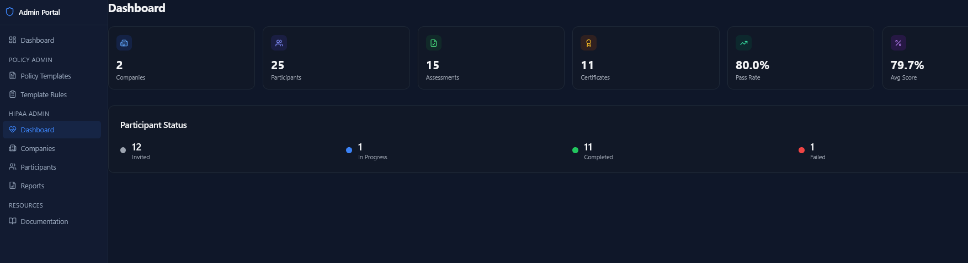
ADMIN
HIPAA PARTICIPANT TRACKING
For admins: who's invited, in progress, passed.
A live participant dashboard surfaces invited, in-progress, completed, and failed counts — plus a pass-rate and average-score readout. Compliance leads see assessment status across every tenant they administer, with drill-downs by company, participant, and report.
Notes:
On the admin side, compliance leads get a live dashboard: who's been invited, who's in progress, who's completed, who's failed — plus pass rate and average score. Drill-downs by company, participant, and report make it easy to chase the last few stragglers before a deadline.

Slide 16
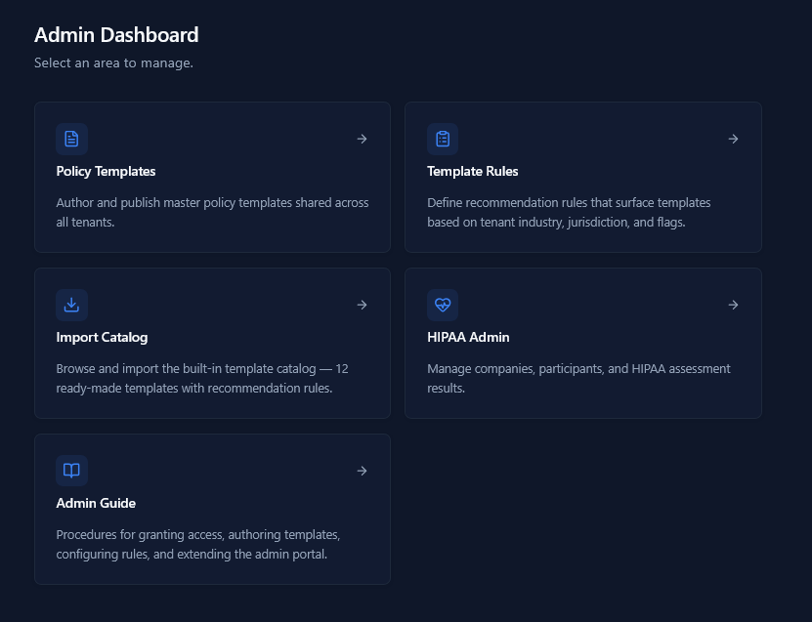
⌘
PLATFORM ADMINISTRATION
One control plane behind every tenant.
Author master policy templates, define recommendation rules, import from a built-in catalog, and govern the HIPAA programme — all from a single admin portal.
TEMPLATES
Author once
Master policies with placeholders for tenant-specific values.
RULES
Recommend smartly
Industry, jurisdiction, and business-flag-driven matches.
CATALOG
Import in bulk
12 ready-made templates with rules attached.
Notes:
Behind the four main modules sits a single admin portal. From here you author master policy templates, define recommendation rules, and import from a built-in catalog of twelve ready-made policies.

Slide 17
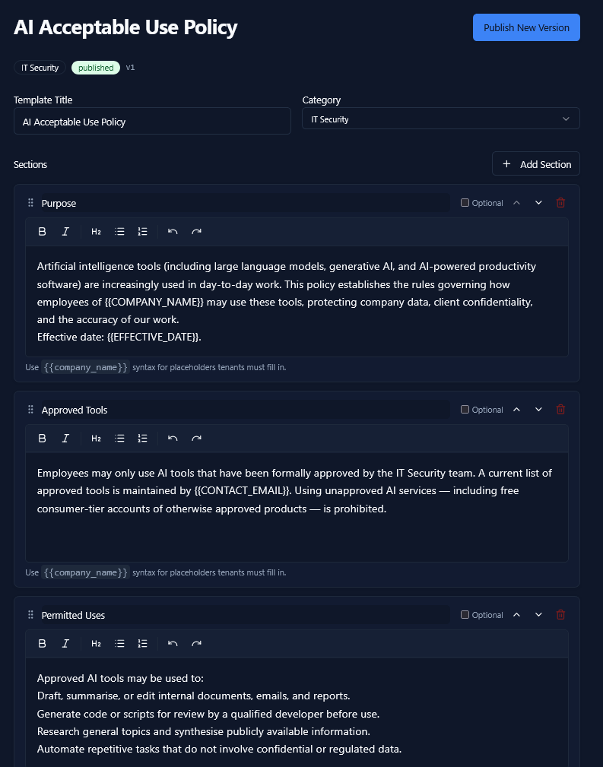
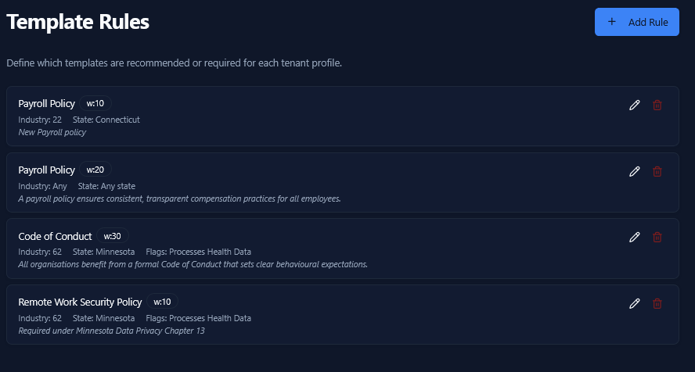
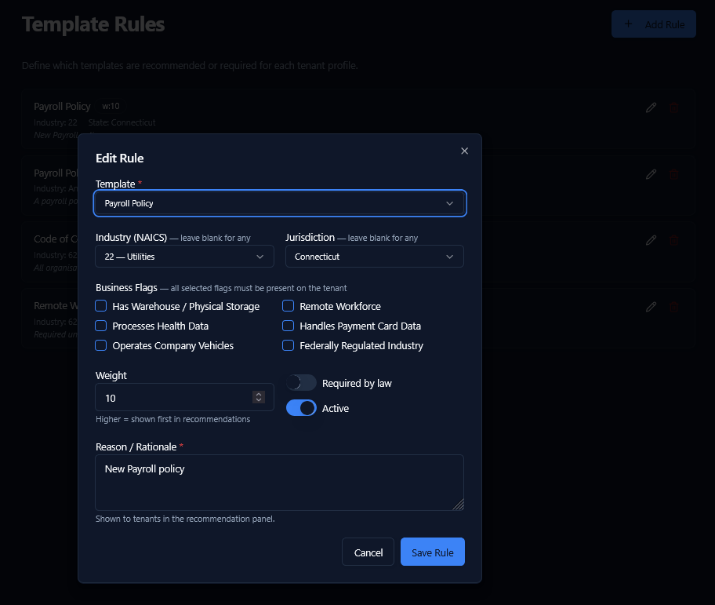
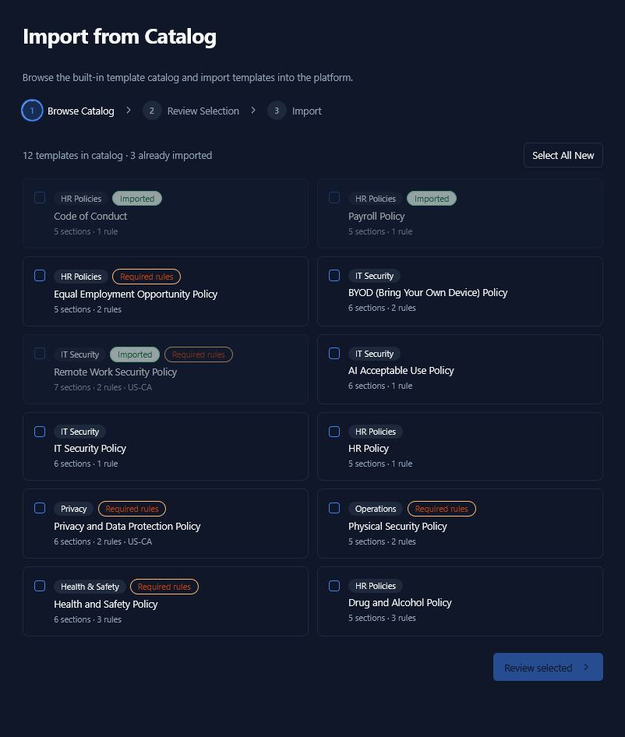
⌘
TEMPLATES · RULES · CATALOG
From one master template to the right policy for every tenant.
Edit a template once with placeholders. Attach rules — NAICS code, state, business flags. Tenants see only the policies that match their profile, ready to publish.
01 · AUTHOR
02 · RULE LIST
03 · MATCH
04 · IMPORT
Notes:
The flow is: author a template once with placeholders. Attach rules — NAICS code, state, business flags. Tenants then see only the policies that match their profile, with placeholders ready for their company-specific values. Or skip the authoring entirely and import from the catalog.

Slide 18
M —
ROLES & APPROVALS
Five built-in roles. Sensible defaults out of the box.
ROLE
VIEW
ADD ASSET
EDIT EMPLOYEE
APPROVE
CONFIGURE
Super
●
●
●
●
●
Admin
●
●
●
●
●
Manager
●
●
—
●
—
Employee
●
● pending
—
—
—
Viewer
●
—
—
—
—
Employees can add customers and suppliers — admins flip them from pending to active.
Notes:
Five built-in roles cover almost every SMB org chart. Employees can add records, but admins approve them. No custom IAM project required.

Slide 19
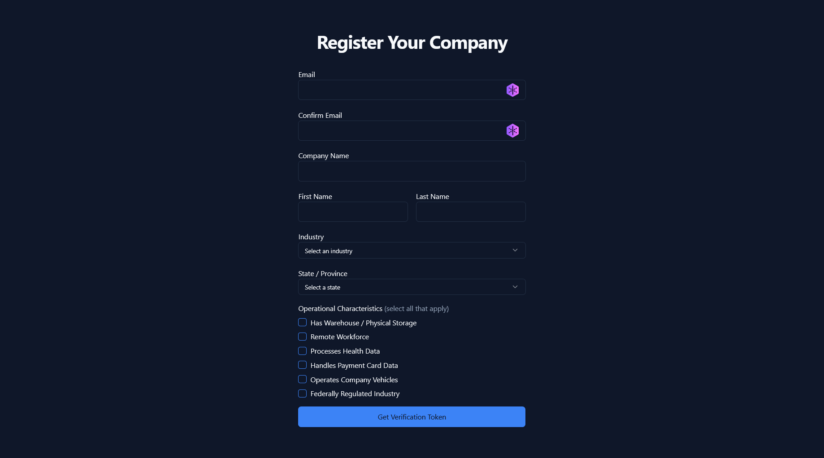
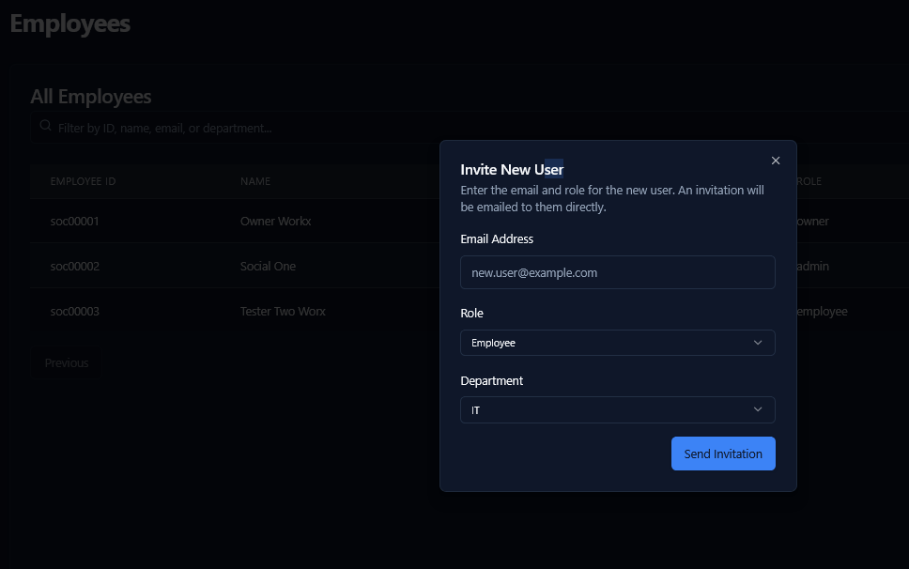
M —
ONBOARDING
From signup to your first assessment in under five minutes.
STEP 01
STEP 02
STEP 03
STEP 04
Register
Verify
Invite team
Start
Email, company name, industry, and state. That's the form.
Token-based email verification. No phone tree.
Add admins and employees with role-scoped invites.
Risk assessment is already tailored to your NAICS.
~ 90 seconds
~ 30 seconds
~ 60 seconds
→ ready
Notes:
A new tenant is up and running in under five minutes. Industry, state, operational characteristics — that's the entire signup, and the questionnaire is already tailored.

Slide 20
IN PRACTICE
A typical week with PRIAM.
Mostly two-minute check-ins. Occasionally a deeper assessment. Always one place to look.
MONDAY
TUESDAY
WEDNESDAY
THURSDAY
FRIDAY
Owner check-in
Phishing email
Quarterly assessment
Policy update
Lost laptop
Reviews dashboard. 0 pending policy ack.
Employee files incident. Auto-routed to IT.
Risk score rises 8 pts on data privacy.
New remote-work policy goes from draft to published.
Reported, asset record flagged, manager notified.
Onboard new hire
Three new suppliers
Resolved
Manager invites; admin approves.
Filed by ops, awaiting verification.
Tuesday's phishing incident closed by IT lead.
Notes:
Here's how a small operations team actually uses PRIAM across a typical week. Mostly quick check-ins, with the occasional deeper assessment.

Slide 21
03
WHY US
Four reasons PRIAM fits where enterprise GRC doesn't.
01 — SIMPLICITY
02 — ADAPTIVE
Intuitive on day one.
Industry-tailored questionnaires.
No consultant rollout. Your office manager can drive it.
NAICS-aware DAG engine asks only what's relevant.
03 — QUEUE-BASED
04 — ASSEMBLED
Incidents have owners, not inboxes.
Policy, risk, incident, asset — together.
BullMQ-backed transitions, audit trail, notifications.
One login. One source of truth. Recommendations that connect.
PRIAM 15 / 20
Notes:
Why us. Simple, intuitive, queue-based incidents, adaptive questionnaires — and a real assembly of productive functions instead of one narrow tool.

Slide 22
04
ARCHITECTURE
Multi-tenant by design.
Every record carries a tenant ID. Isolation is enforced at the database query layer — not bolted on at the application edge.
Northwind Retail
Cedar & Co.
Mendoza Logistics
Your business
tenant_a91f
tenant_b30c
tenant_c7e2
tenant_xxxx
employees · 23
employees · 11
employees · 48
isolated
incidents · 4
incidents · 1
incidents · 9
encrypted
policies · 6
policies · 4
policies · 12
audited
Notes:
Multi-tenant by design. Every record carries a tenant ID; isolation is enforced at the database query level, not bolted on after the fact.

Slide 23
05
SECURITY & DATA HANDLING
Boring, dependable security primitives.
IDENTITY
AUTHORIZATION
Firebase Authentication
RBAC at the API layer
Industry-standard auth, MFA-ready, with token-based session management.
Every API route runs through withAuth + checkAccess.
AUDIT
RETENTION
Immutable trails
Lifecycle defaults
Assessment evaluations and incident transitions log to append-only collections.
Risk assessments expire after 6 months; tenants can extend per record.
Notes:
Firebase auth, RBAC at the API layer, immutable audit trails on every assessment. Boring, dependable security primitives — the kind we want.

Slide 24
06
WHAT'S NEXT
Roadmap.
NOW — Q2 '26
NEXT — Q3 '26
LATER — Q4 '26+
Policy management + acknowledgement
Adaptive risk assessment (DAG engine)
Queue-based incident workflow
Asset registry & RBAC
Profile change workflows
Notification rules & digest
HIPAA & SOC 2 add-on packs
Slack & Teams integration
Open API & webhooks
Vendor risk scoring
Mobile incident reporting
Industry packs: retail, logistics, healthcare
Notes:
What's coming next. Profile change workflows, deeper notifications, more industry packs, and an open API.

Slide 25
AUDIENCE
If you're wearing the compliance hat — this is for you.
5–50 EMPLOYEES
10–200 EMPLOYEES
The owner-operator
The ops lead
Running ops, compliance, and HR on the side of the actual business.
Wants a dashboard that doesn't require a vendor relationship to interpret.
FIRST-TIME COMPLIANCE
REGULATED BY DEFAULT
The founder under contract pressure
The healthcare or fintech SMB
Customers asking "do you have a security program?" — needs one this quarter.
Needs HIPAA / PCI / SOC 2 hooks without an enterprise GRC platform.
Notes:
If you're a small business owner, an ops lead, or a founder wearing the compliance hat — this is for you.

Slide 26
PRIAM · RISK & ASSET MANAGEMENT
Two ways to get started.
SELF-SERVE
GUIDED
Start a free trial
Book a 20-min walkthrough
Tenant created in under five minutes. First assessment ready immediately. No card required for the trial.
We'll set you up with sample data for your industry. You'll see exactly what your first month looks like.
priam.app/start
priam.app/demo
Thank you.
Notes:
Two ways to start: a self-serve trial or a 20-minute walkthrough with us. Thank you.

